Slide 1
UNIX multi-process programming
using fork

Slide 2






PID related Functions
getpid();
getppid();

Slide 3

fork(): creating new process
#include<sys/ types.h> #include<unistd.h>
pid_t fork(void);

Slide 4
fork returns
In parent :
In child : 0
-1 :
pid of the child
on errors

Slide 5






wait() function
#include<sys/ types.h> #include<sys/ wait.h>
pid_t wait ( int *status );

Slide 6
Main Memory
if (pid == 0) {
printf ( “Child Process\n”);
}
else {
printf ( “Parent Process\n”);
}
Secondary Memory
Parent Process Address Space
pid = fork (); if (pid == 0) {
printf ( “Child Process\n”);
}
else {
printf ( “Parent Process\n”);
}
if (pid == 0) {
printf ( “Child Process\n”);
}
else {
printf ( “Parent Process\n”);
}
Child Process Address Space
Fork() returns twice

Slide 7

fork()
#include <stdio.h>
#include <sys/types.h>
#include <unistd.h>
int main()
{ fork();
printf("Hello world!\n");
return 0;
}

Slide 8
fork()
#include <stdio.h>
#include <sys/types.h>
int main()
{
fork();
fork();
fork();
printf("hello\n");
return 0;
}

Slide 9
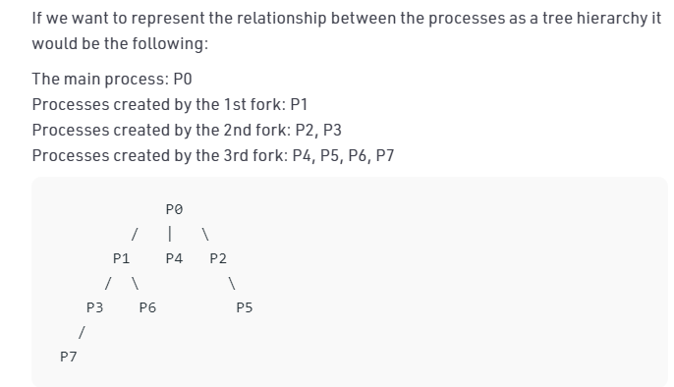
fork()
#include <stdio.h>
#include <sys/types.h>
int main()
{
fork();
fork();
fork();
printf("hello\n");
return 0;
}
Output:
hello
hello
hello
hello
hello
hello
hello
hello
here n = 3, 2³ = 8

Slide 10
fork()
void forkexample()
{ if (fork() == 0)
printf("Hello from Child!\n");
else
printf("Hello from Parent!\n");
}
int main()
{
forkexample();
return 0;
}

Slide 11
fork()
void forkexample()
{ int x = 1;
if (fork() == 0)
printf("Child has x = %d\n", ++x);
else
printf("Parent has x = %d\n", --x);
}
int main()
{ forkexample();
return 0;
}

Slide 12
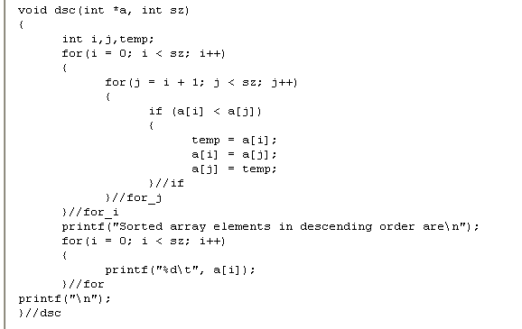

Slide 13
#include<stdio.h>
#include<sys/types.h>
#include<unistd.h>
#include<stdlib.h>
#include<sys/wait.h>
/* pid_t : is a long integer type data type...prototype in types.h */
pid_t num_pid,cpid;
int i;
void main() {
num_pid=fork(); /* return value of fork */
if(num_pid<0)
printf("Error in fork execution");
else
if(num_pid==0) /* this is child process */ {
printf("this is the child process id %d\n",getpid());
printf("child completed\n"); }

Slide 14
else /* this is parent process */
{
printf("this is the parent id %d\n",getpid());
wait(NULL);
printf("********parent exiting after child completed\n");
}
exit(0);
}

Slide 15


Problem Statement – I : Program where parent process sorts array elements in descending order and child process sorts array elements in ascending order.

Slide 16
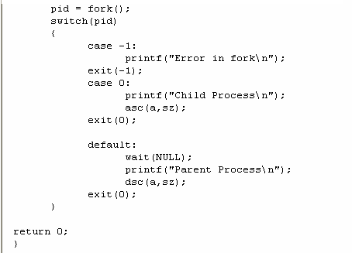

Slide 17
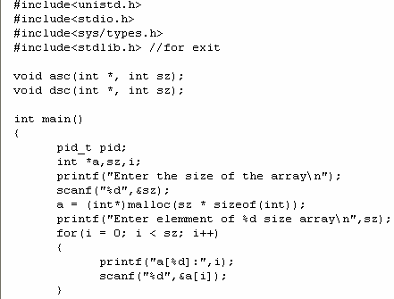

Slide 19
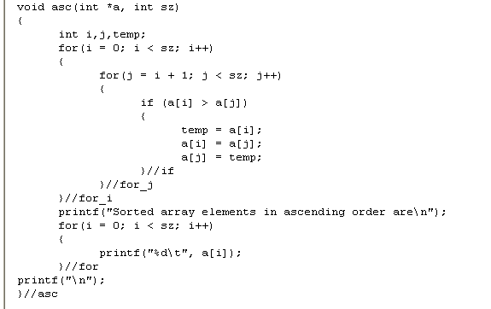

Slide 20
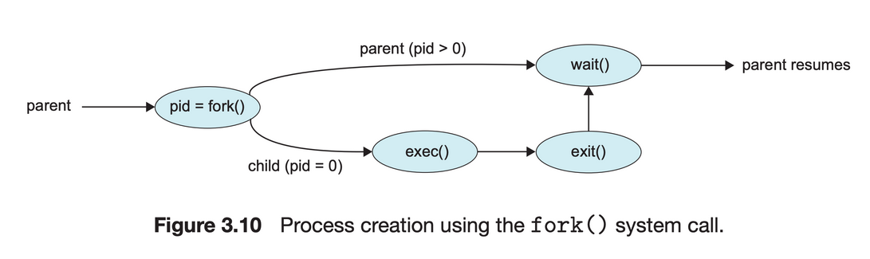
Zombie processes
A zombie process is a process whose execution is completed but it still has an entry in the process table.
Zombie processes usually occur for child processes, as the parent process still needs to read its child’s exit status.
Once this is done using the wait system call, the zombie process is eliminated from the process table.
Zombie processes don't use any system resources but they do retain their process ID. .
The original process calls fork, which creates a child process. The child process then uses exec to start the execution of a new program. Meanwhile, the parent uses wait() to wait for the child process to finish.

Slide 21
#include<sys/types.h>
#include<unistd.h>
#include<stdio.h>
#include<stdlib.h>
int main(void)
{
pid_t pid;
if((pid=fork()) < 0)
printf("\tfork error\n");
else
if(pid==0) {
printf(" ");
printf("child process id is %d\n",getpid());
}
else
{
sleep(2);
printf("*****parent\n");
system("ps -axj | tail");
}
exit(0);
}
Zombie processes
Child becomes Zombie as parent is sleeping ,when child process exits

Slide 22
Zombie processes output
/*****OUTPUT
child id is 3925
*****parent
2 3801 0 0 ? -1 S 0 0:00 [kworker/0:2]
2 3804 0 0 ? -1 S 0 0:00 [kworker/3:0]
2 3847 0 0 ? -1 S 0 0:00 [kworker/1:0]
2 3894 0 0 ? -1 S 0 0:00 [kworker/u8:1]
2 3914 0 0 ? -1 S 0 0:00 [kworker/3:2]
2471 3924 3924 2471 pts/4 3924 S+ 1001 0:00 ./a.out
3924 3925 3924 2471 pts/4 3924 Z+ 1001 0:00 [a.out] <defunct>
3924 3926 3924 2471 pts/4 3924 S+ 1001 0:00 sh -c ps -axj | tail
3926 3927 3924 2471 pts/4 3924 R+ 1001 0:00 ps -axj
3926 3928 3924 2471 pts/4 3924 D+ 1001 0:00 sh -c ps -axj | tail
**/

Slide 23
Orphan Processes
Orphan processes are those processes that are still running even though their parent process has terminated or finished.
A process can be orphaned intentionally or unintentionally.
in this case, init will adopt it and will wait for it.

Slide 24
In the following code, parent finishes execution and exits while the child process is still executing and is called an orphan process now. However, the orphan process is soon adopted by init process, once its parent process dies.
#include<stdio.h> #include <sys/types.h> #include <unistd.h>
int main()
{ int pid = fork();
if (pid > 0){
printf("in child process id %d\n“, getpid());
printf(“parent process id%d\n“, getppid());
}
else if (pid == 0)
{ sleep(10);
printf(“child process id %d\n“, getpid());
printf(“parent process id %d\n“, getppid());
}
return 0;
}

Slide 25
Orphan processes output
/**output
child process id 4061
parent process id 4060
student@c04l0324:~$
child process id 4061
parent process id 1
**/

